Slide 2
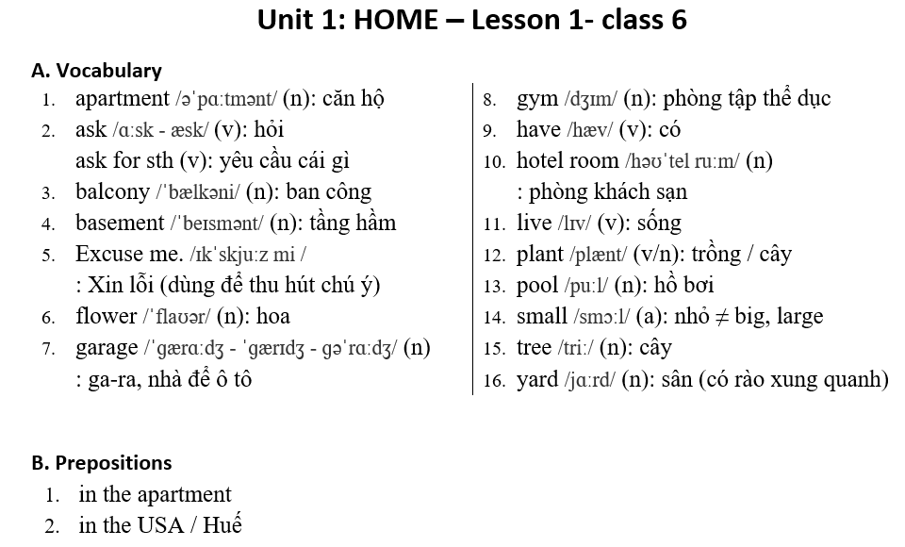

Slide 3
Lesson 1
6
5
2
3
4
Notes:
Click on the words, they will move and match up with the pictures.

Slide 4
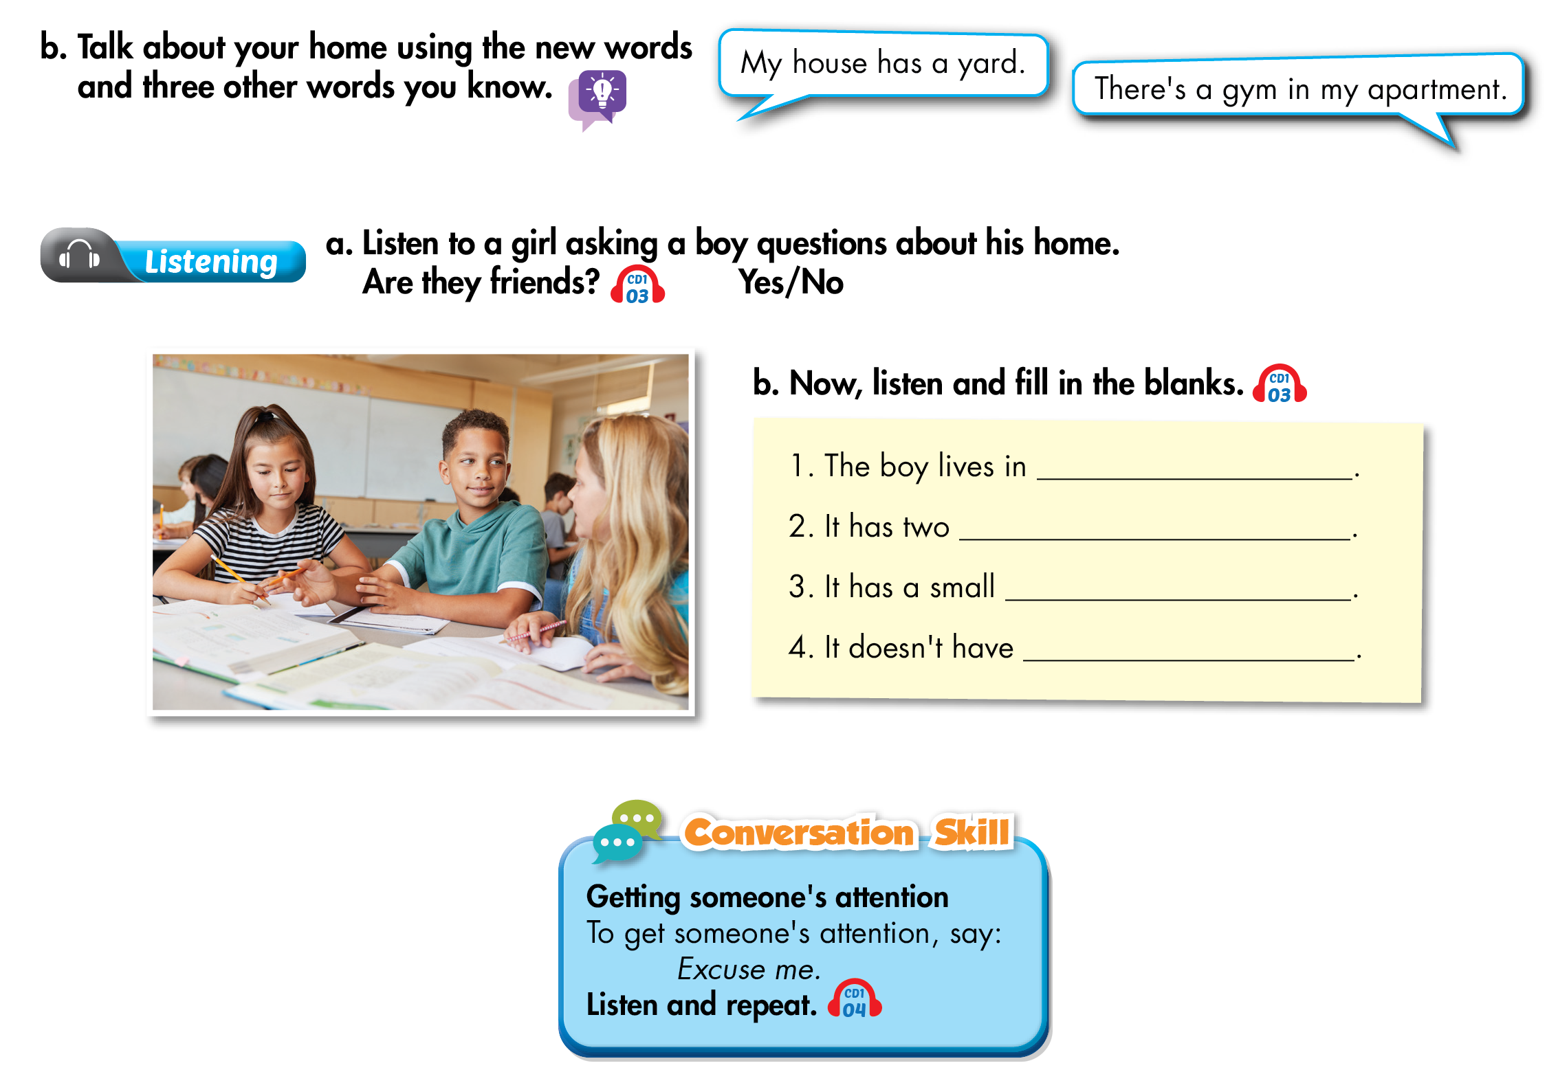
Lesson 1
an apartment
bedrooms
pool
garage

Slide 5
Lesson 1

Slide 6
Lesson 1

Slide 7
Lesson 1

Slide 8
GOOD BYE
SEE YOU AGAIN

